Slide 1
.NET 5.0 in salsa desktop: le novità per gli sviluppatori Windows
Matteo Pagani
Windows App Consult Engineer @ Microsoft
matteo.pagani@microsoft.com
Twitter: @qmatteoq | GitHub: qmatteoq

Slide 2
SPONSOR

Slide 3


.NET
Your platform for building anything
Desktop
Web
Cloud
Mobile
Gaming
IoT
AI

Slide 4
The future of .NET Framework
.NET Framework 4.8 is the last major version of .NET Framework on Windows
Support policy remains the same:
Will always be in Windows
Will be patched with Windows
Will be supported with Windows
Keep existing mature applications on .NET Framework
Recommend .NET Core for new applications or existing applications which will continue to be evolved

Slide 5

Why Windows desktop on .NET 5.0?
Deployment flexibility
Side-by-side support
Machine global or app local framework
Self-contained EXEs
Core runtime and API improvements
Performance
X
=

Slide 6
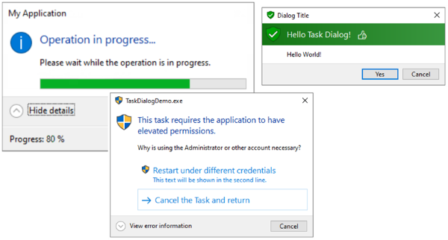
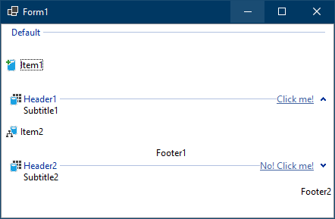
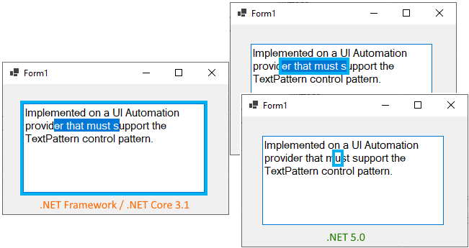
New features in Windows Forms
New TaskDialog control
ListView enhancements
Accessibility improvements

Slide 7
Microsoft Update
The problem for IT Administrators: keeping .NET runtime up-to-date with security fixes
The solution: Microsoft Update will distribute runtime updates
Easily deployed with SSCM, Intune, etc.
It will push only minor revisions
If you have .NET 5.0:
You will get 5.0.x
You won’t get 5.1 or 6.0

Slide 8
Target framework for Windows apps
<Project Sdk="Microsoft.NET.Sdk">
<PropertyGroup>
<OutputType>WinExe</OutputType>
<TargetFramework>net5.0-windows</TargetFramework>
<UseWPF>true</UseWPF>
</PropertyGroup>
</Project>
<Project Sdk="Microsoft.NET.Sdk.WindowsDesktop">
<PropertyGroup>
<OutputType>WinExe</OutputType>
<TargetFramework>netcoreapp3.1</TargetFramework>
<UseWPF>true</UseWPF>
</PropertyGroup>
</Project>
Support to Windows 7, 8 and 10
Access to specific Windows APIs like:
Registry
Event Viewer
WCF services
Windows Services

Slide 9
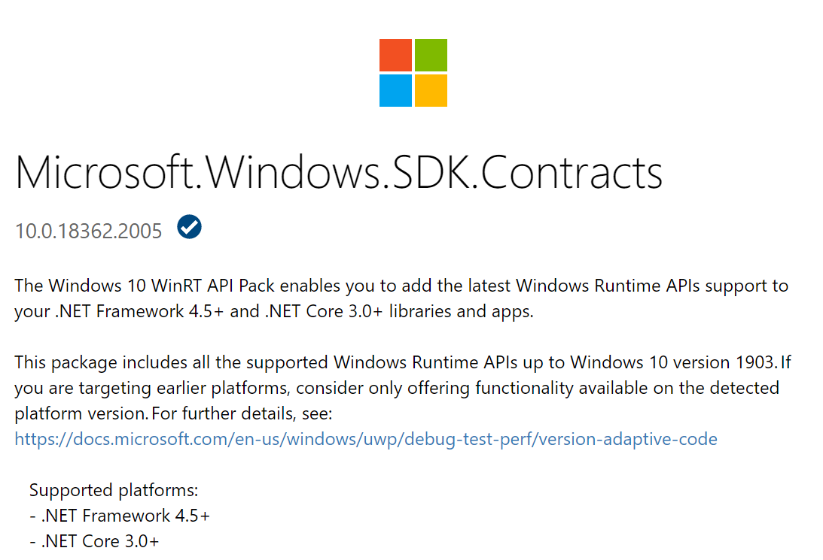
.NET Framework and .NET Core 3.x
The WinRT projection are included in the compiler
Package available on NuGet to reference the correct metadata
Get access to all the UWP APIs from a .NET application
https://www.nuget.org/packages/Microsoft.Windows.SDK.Contracts

Slide 10
C# / WinRT
NuGet-packaged toolkit that provides Windows Runtime (WinRT) projection support for the C# language
It enables .NET 5.0 application to access to Windows Runtime APIs
Geolocation
Bluetooth
Biometric authentication
Notifications
And much more…
It enables to consume Windows Runtime components in a .NET 5.0 application

Slide 11
New approach in .NET 5
It leverages the C# / WinRT project
The goal is to make .NET completely agnostic, by lifting the WinRT projection support out of the compiler
No more NuGet packages to reference
Just target the specific TFM
<Project Sdk="Microsoft.NET.Sdk">
<PropertyGroup>
<OutputType>WinExe</OutputType>
<TargetFramework>net5.0-windows10.0.19041.0</TargetFramework>
<UseWPF>true</UseWPF>
</PropertyGroup>
</Project>
Supported versions
10.0.17763.0
10.0.18362.0
10.0.19041.0

Slide 12
Using Windows Runtime APIs
Demo

Slide 13
Consuming Windows Runtime components
You can use C# / WinRT to create a projection library for a Windows Runtime Component
You can pack this library into a NuGet component or just distribute the DLL
Use the library from a .NET 5.0 application
<PropertyGroup>
<CsWinRTIncludes>GeolocationComponent</CsWinRTIncludes>
<CsWinRTGeneratedFilesDir>$(OutDir)</CsWinRTGeneratedFilesDir>
</PropertyGroup>

Slide 14
Consuming a Windows Runtime component
Demo

Slide 15
Making apps great for the people who use them
Support new hardware
Modern user experience
App deployment and management
Reliability, security, and privacy
System performance and battery life
Notes:
A few aspects have emerged as particularly transformative in this era we’ve been evolving the Windows platform to help you achieve.
- Supporting new hardware – with investments up and down the os stack to support ARM, latest sensors, graphics technology (used for both display and AI with things like Windows ML), touchpads and touch screens and pens, mixed reality
Modern user experiences – ux patterns and interactions have evolved, both to support new inputs and intew scenarios like artificial intelligence, and with greater expectations for immersiveness, animations, etc.
How apps are deployed and managed – not everyone is on corporate networks, and that’s not sufficient for all the needs, and users demand to be able to install and run apps without worrying about winrot or their ability to uninstall them later
Reliability, security, and privacy - nobody wants to put a piece of tape over the camera on their laptop – so the platform needs to evolve to create a contract between the app and the os that guarantees users are in control of access to resources like their files or sensitive sensors like cameras
System performance and battery life – achieving really good system performance and battery life requires greater coordination between the os (which has a view of overall what the user is doing, and overall the state of the system) and the app (which knows specifically in the app what the user is doing and what the app needs to get done). We’ve brought advanced lifetime management capabilities to the platform to enable this coordination.
We’ve been bringing these advancements to you as part of the Universal Windows Platform.
Support new hardware Innovations ->

Slide 16

Starting where you are
Compatibility with all your code – WinForms, WPF, MFC…
Support for your existing packaging and deployment
Features that work across users’ versions of Windows 10
Notes:
But we’ve heard your feedback that building or rebuilding apps to take all those modern capabilities into account can be a heavy investment.
There’s a lot to take into account, for example:
The fact that many companies and developers have a lot of assets in their existing desktop app codebases, so you want something very compatible with the desktop win32 technologies you’re currently using.
You also might want the benefits of newer packaging and installer tech like Paul mentioned, but again you’re starting with an existing set of technologies you’re using today.
And finally, your users may be spread across different versions of Windows that don’t always have the latest updates.

Slide 17
Notes:
So, what we need is a common platform and a less complicated way to design or update apps for Windows that lets you take your existing investments and more incrementally update them with modern capabilities that work for all users.

Slide 18
Project Reunion
Notes:
And that’s where Project Reunion comes in.
Project Reunion isn’t a new platform: it’s our long-term effort to unify access to the desktop and UWP platforms that apps are using today, and then continue to incrementally evolve the Windows API going forward.
It’s really an expansion on our efforts over the last couple years to break down the barrier between UWP and Win32 and add new capabilities to the platform, to really make it easier for you to build a single Windows app that can reach all the Windows 10 versions and devices people use.

Slide 19
Desktop Apps, Libraries
UWP Apps, Libraries
Today
Windows OS
Desktop APIs
UWP APIs
A
B
C
D
E
Notes:
When we talk about compatibility, we have to start with where apps are today.
Today when you write apps or libraries for Windows they generally call directly into desktop APIs or UWP APIs, which are part of the OS.

Slide 20
Desktop Apps, Libraries
UWP Apps, Libraries
Today
Windows OS
Desktop APIs
UWP APIs
A
B
C
D
E
Notes:
Over time we’ve brought more Desktop APIs into UWP – for example more file system APIs - and also enabled Desktop apps to call some WinRT UWP APIs.
But we can make this even simpler and more powerful.

Slide 21
Project Reunion APIs via decoupled package
Desktop Apps, Libraries
UWP Apps, Libraries
Project Reunion
Windows OS
Desktop APIs
A
B
C
D
E
UWP APIs
Notes:
In order to do that, with Project Reunion we’re iteratively taking the APIs you use today across UWP and Desktop apps like WPF, WinForms and C++ apps and decoupling them from the OS, by making them available via package managers like NuGet, our package manager for .NET, C++ and React Native apps.
This will allow you to mix and match from the APIs that work best for your app and adopt new capabilities on demand.

Slide 22
Windows Apps, Libraries
Project Reunion APIs via decoupled package
Project Reunion
Windows OS
Desktop APIs
C
D
E
A
B
UWP APIs
Notes:
And over time our goal is that this will allow the distinction between apps that see themselves as apps writing to the Desktop APIs or to the UWP APIs to fade away.
And shipping via this model also gives us other benefits

Slide 23
Agility through backwards compatibility
Accent 1
Accent 2
New APIs and platform improvements can become instantly available, without waiting for user os updates to catch up.
Accent 3
2017
2018
2019
2020
New feature via OS
1909
2004
1703
1709
1803
1809
1903
2004
Accent 4
Your customer must run this
Accent 5
1709
1803
1809
1903
1909
2004
New feature via
Project Reunion
1703
1709
1803
1809
1903
1903
2004
Accent 6
Your customer can run any of these
Notes:
And since these are NuGet packages, they aren’t coupled to OS versions.
You can always use the latest APIs from a Project Reunion NuGet package without waiting for your users to update their OS like you have to do today, since the packages we release will polyfill gaps downlevel as needed.

Slide 24
Web experiences

Slide 25



Supporting web experiences
WebBrowser control in WPF and Windows Forms
Welcome new WebView2 control!
Notes:
And since these are NuGet packages, they aren’t coupled to OS versions.
You can always use the latest APIs from a Project Reunion NuGet package without waiting for your users to update their OS like you have to do today, since the packages we release will polyfill gaps downlevel as needed.

Slide 26
WebView2
Based on Edge Chromium engine
Supports WPF, Windows Forms, C++ and UWP
It’s independent from the Edge browser, but it needs the WebView2 runtime
Two deployment approaches:
Evergreen: the installer takes care of keeping the runtime up-to-date
Fixed version: you must manually upgrade to newer versions
Development and testing phase: use a non-stable Edge version
Beta
Dev
Canary

Slide 27
Demo
WebView 2

Slide 28
Modern and accessible UI and input

Slide 29

WinUI
Native UI platform for Windows 10
It moves controls and resources from the OS to a NuGet package
It makes easier to leverage UI controls independently from the OS version
More agility in fixing bugs and adding new features
Open source on GitHub: https://github.com/microsoft/microsoft-ui-xaml

Slide 30
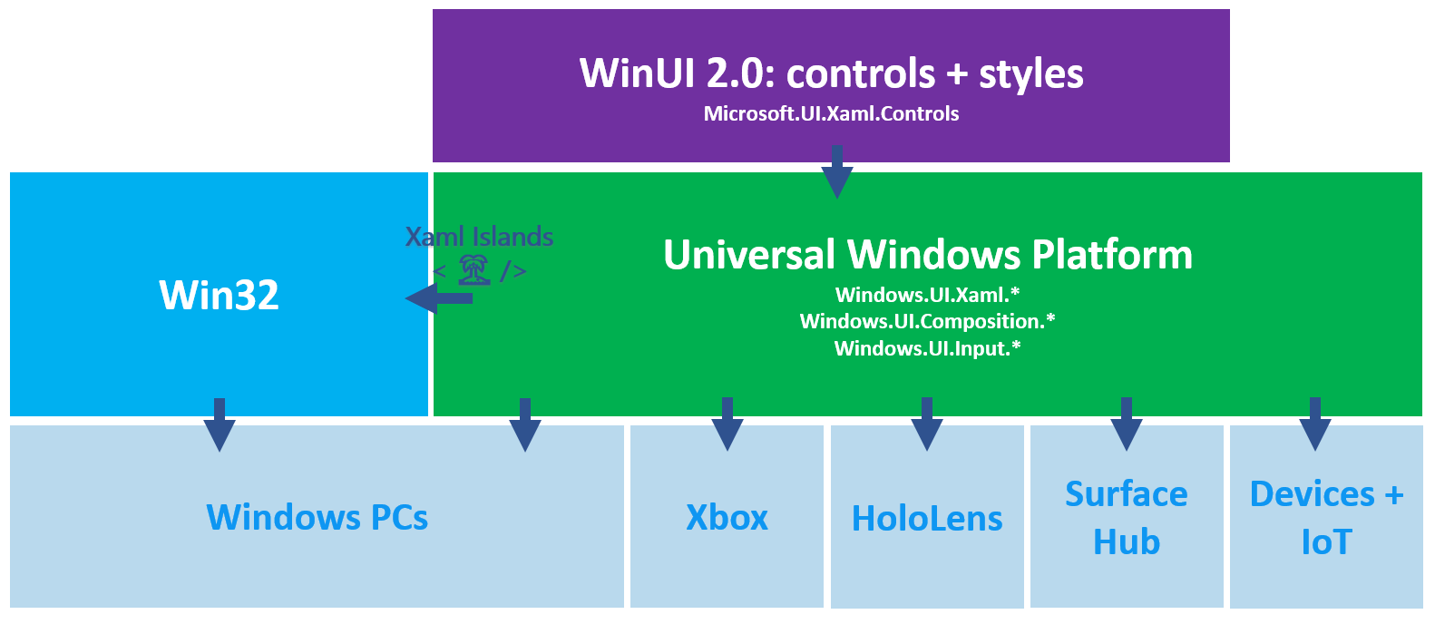
WinUI 2.x

Slide 31
Desktop (Win32) Apps
UWP Apps
MFC
1992
WinForms
2002
WPF
2006
UWP XAML
2012
WinUI 3
Visual Layer
+
WinUI 2
Controls & Styles
Notes:
…with this history in mind, now we can really dig into what WinUI is and what it can do for you.
WinUI stands for the “Windows UI Library”, and many of you might already know about & use WinUI since it’s a product in-market today. We call this product WinUI 2 Series, or just “WinUI 2”.
{**click1**} WinUI 2 is a library of UI controls & styles for UWP XAML apps. It’s mature and it’s been shipping since Oct 2018. The latest release, version 2.4, just came out 2 weeks ago. If you’re a UWP XAML developer and you’re not using WinUI 2 yet, you should look into it today—it’s how we ship all the latest & greatest controls & styles to you.
While WinUI 2 is a library of controls & styles for UWP XAML, {**click 2**} WinUI 3 is literally the entire codebase of UWP XAML, plus all of WinUI 2’s controls & styles, {**click3**} plus other powerful layers of Windows technology including the Win10 Visual Layer, all wrapped up into a single UI framework. This framework will ship independently of the operating system on it’s own cadence, just as WinUI 2 does today.
{**click4-advances slide**}
“…and most importantly, WinUI 3 will work in any type of app—it will work in in UWP apps, but also Desktop apps as well”

Slide 32

Desktop (Win32) Apps
UWP Apps
WinUI 3 will provide a state-of-the-art UX framework for every Windows developer.
MFC
1992
WinForms
2002
WPF
2006
UWP XAML
2012
WinUI 3
Always contains latest Fluent controls & styles
Native UI performance in any app (C++, or .NET)
You choose when to upgrade!
Notes:
…and most importantly, WinUI 3 will work in any type of app—it will work in UWP apps, but also Desktop apps as well.
{**click1**} Remember the one big takeaway I wanted everyone to get from this session: “WinUI 3 will provide a state-of-the-art UX framework for every Windows developer“.
You’ve told us to tear down the walls between Win32 and UWP, and as you’ve already heard from Kevin Gallo earlier at the conference, WinUI 3 will be the first of many Windows platform technologies to do so—this broad initiative is called Project Reunion and at the end of this session I’ll provide details on where you can learn more about that.”
{**click2**} All of this adds up to 3 big advantages that WinUI 3 will provide for everyone:
First, it will offer cutting edge Fluent controls and styles for apps that really care about having the best user experience
Second, WinUI 3 itself it is implemented in C++, meaning that no matter whether you’re using it in a C++ or a .NET app, your UI will have native performance and it won’t pull in the .NET CLR on it’s own
And finally, because WinUI 3 will ship separately from the operating system, that means you decide when to upgrade. If you’re happy with WinUI 3.1, you don’t ever have to move to version 3.2. The choice is yours.
There’s two other things I want to point out here:
{**click3**} First, you can see that I wrote “a UX framework” rather than “the UX framework”. When WinUI 3 becomes ready for use in production apps, there’s still good reasons to use {**click4**} the previous technologies listed here. There are hundreds of millions of apps written with these existing frameworks that can’t and really shouldn’t be re-written. And even for new apps, these older frameworks will be the right choice to use in some situations; for example, people have familiarity with them and they might meet your needs just fine.
WinUI 3 isn’t about replacing Microsoft UI frameworks of the past, it’s about offering everyone a modernized choice: something new for those than want a contemporary option that offer native performance, puts you in control, and works best on today’s advanced devices with high DPI screens and the latest types of input.
Second, for UWP developers, you shouldn’t think of WinUI 3 as a new framework that makes UWP XAML obsolete. Think of it instead as the continuation of UWP XAML, but just kind of rebranded {**click5**}—it’s basically just the next version of UWP XAML, but now everyone can use it. Some of you will be able to upgrade from UWP XAML to WinUI 3 just as easily as doing a find-and-replace operation to change namespaces.

Slide 33
Demo
WinUI 3.0 Preview 3

Slide 34
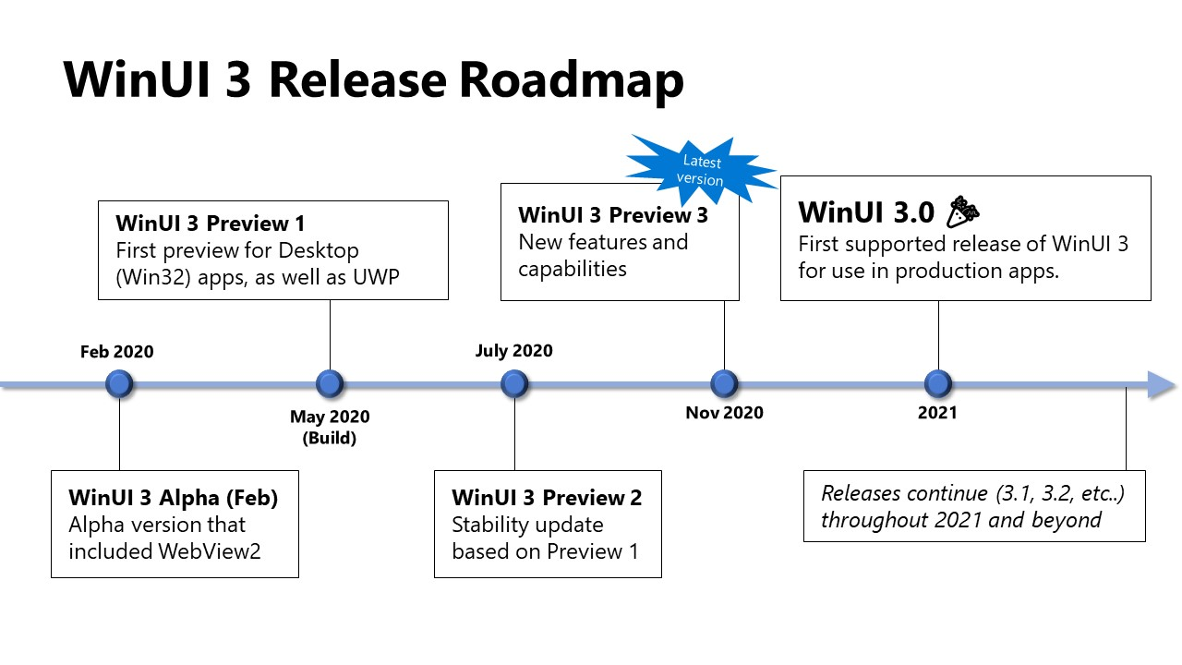
Notes:
To give you a sense of what’s coming for WinUI 3, let’s walk thru our roadmap.
{**click1**} In February we released a refreshed version of our WinUI 3 Alpha that added WebView2, based on the Chromium web engine.
{**click2**} Today [yesterday] we released WinUI 3 Preview 1, which is the first release of WinUI 3 that allows Desktop-style, or Win32 apps, to use WinUI in addition to UWP apps. We’ll talk more about Preview 1’s capabilities in just a little bit.
{**click3**} A month after Build we’re going to release WinUI 3 Preview 2. Preview 1 has some stability issues that we weren’t able to address before the conference, but we didn’t want to hold Preview 1 back, so Preview 2 will essentially be a more stabilized version of Preview 1 but with the same capabilities.
{**click4**} And then in late summer or early fall, we hope to switch the project to being open source. This includes not only the full XAML layer source code, but also how we plan and track our work as well. Some of you already engage with us on our WinUI 2 GitHub repository and I know our team is eagerly looking forward to this same engagement for WinUI 3.
{**click5**} At Ignite in September we’ll ship Preview 3, which will bring more capabilities & features, and then {**click6**} in November, we’ll ship WinUI 3 Preview 4.
In the past we’ve called this the “RTM” or “General Availability” release, but as we all know COVID-19 has delayed the world; we know it’s causing delays in your plans, and it’s causing some delays for us too. We expect there will be some noteworthy capabilities missing in the November release compared to what UWP XAML can do, so we’re going to keep using the “Preview” nomenclature for November. We still anticipate this to be the first release of WinUI 3 that is “forward compatible”—that means we expect it to be stable, and you can build production apps on it as long as it contains the specific features you need for your specific app.
{**click7**} …and if it doesn’t have all the features you need, then we’ll keep shipping previews with new capabilities heading into 2021 until we hit a broad level of capability that we, and more importantly you as our community, agree should be called “version 3.0”.
Our open source milestone is the centerpiece of this thinking; we want to get open so you can see the work unfold and weigh in on readiness, and which capabilities to add next.

Slide 35
ClickOnce is back!
But I wouldn’t use it ☺
MSIX is the way forward to deploy Windows applications:
Clean install and uninstall
Automatic updates
Differential updates and storage optimizations
Easy integration with CI/CD pipelines
Add a Windows Application Packaging Project to your solution to package your .NET 5.0 app as MSIX
https://aka.ms/msix

Slide 36
https://github.com/qmatteoq/DotNetConf2020-Rome
Ask me about the Windows Developer Enterprise TAP!
Matteo Pagani
Windows App Consult Engineer @ Microsoft
matteo.pagani@microsoft.com
Twitter: @qmatteoq | GitHub: qmatteoq

